Slide 1

Sticky Science:
Sixty Years of Research and (In)Action on Fluorinated Compounds
Phil Brown
Northeastern University
Environmental Justice and the Future of Environmental Health Research- Rutgers University April 28, 2017
Funding: EPA STAR Fellowship (FP-917119), NIEHS (1R01ES017514 - 01A1 and
1R13 ES028097-01), NSF (SES-0924241 and SES-1456897 )

Slide 2
Questions; Material needed to finish this presentation
Before 1981, what negative effects of PFAS did DuPont and 3M know?
Why are we saying “60 years?”
Brief mention of other organized communities
Does the flame retardant comparison (#27-31) work? I’m fine with deleting it.

Slide 3
Our team
Phil Brown – PI – Northeastern
Alissa Cordner – Co-PI – Whitman College
Postdocs
Vanessa De La Rosa – Northeastern/Silent Spring Institute
Jennifer Ohayon – Northeastern/Silent Spring Institute
Graduate Students
Lauren Richter – Northeastern
Elicia Cousins – Northeastern
Tibrine De Fonseca – Northeastern
Marina Atlas – Northeastern
Undergraduates
Yvette Niwa – Northeastern
Chelsea Canedy – Northeastern
Elizabeth Boxer – Northeastern
Sokona Diallo – Northeastern
Nick Chaves – Northeastern
Clare Malone – Northeastern
Walker Bruhn – Whitman College
Collaborators:
  Laurel Schaider – Silent Spring Institute
  Ruthann Rudel – Silent Spring Institute
  Bill Walker – Environmental Working Group

Slide 4




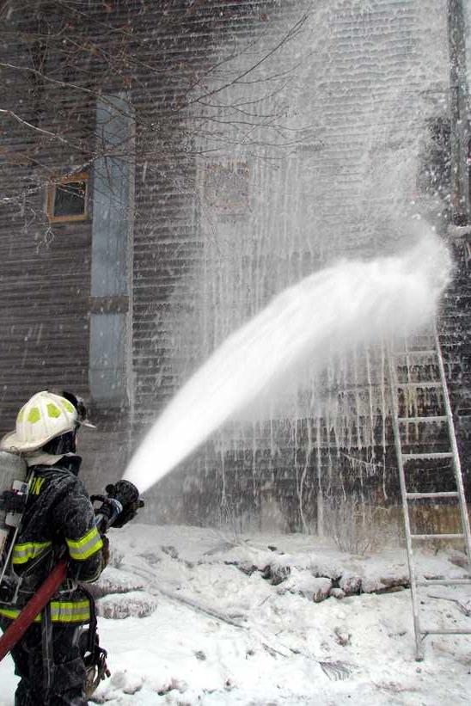

Per- and Poly-fluoroalkyl Substances
PFAS (includes PFCs)
Non-stick, liquid repellant, stain resistance
  PFOA used in Teflon
  PFOS in Scotchguard and Gore-Tex
  Over 3,000 compounds, many with trade secrecy
NHANES finds PFOA in 99% of people
Hundreds of other unknown applications , e.g. cosmetics, dental floss, etc.
Aqueous firefighting foam (AFFF) containing PFASs now showing up widely
  Over 600 military installations
  Airports
  Firefighter training sites
Associated with:
  testicular and kidney cancer
  liver malfunction
  hormonal changes
  thyroid disruption
  obesity
  ulcerative colitis
  Immunotoxicity, incl . interference with cihld vaccine response
  lower birth weight and size

Slide 5
PFASs are one of the Green Science Policy Institute’s Six Classes of harmful chemicals
Highly fluorinated chemicals (PFAS)
Chlorinated antimicrobials
Flame retardants
Bisphenols and phthalates
Organic solvents
Certain Metals
stain and water repellants
triclosan and triclocarban
brominated, chlorinated, phosphate
phthalates, BPA, BPS, etc.
Benzene, methylene chloride, xylene, etc.
courtesy of
lead, mercury, chromium, cadmium, arsenic, etc.

Slide 6
We can think of this as
Chemical Class Consciousness

Slide 7
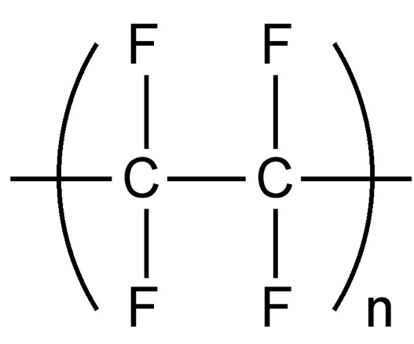
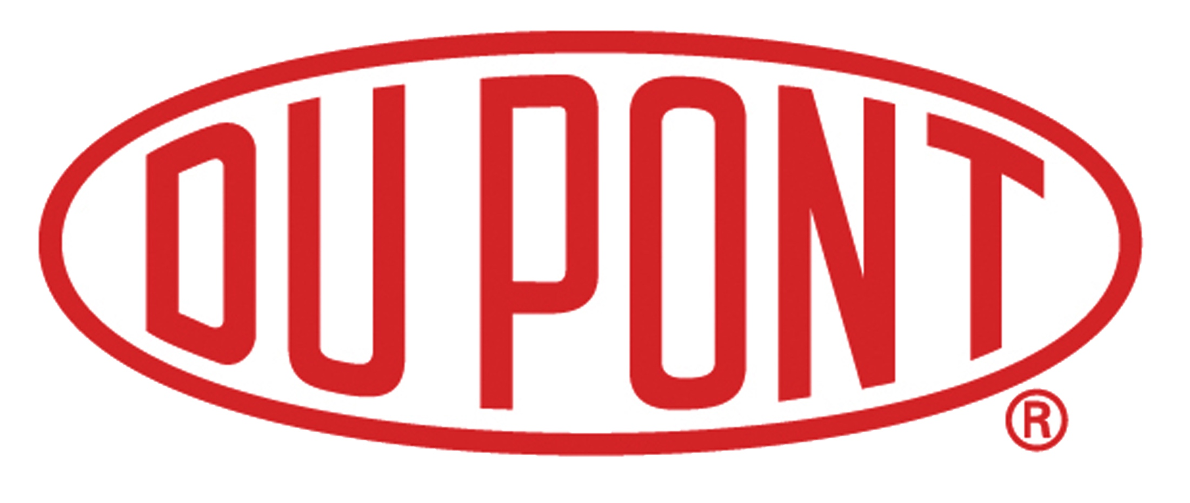

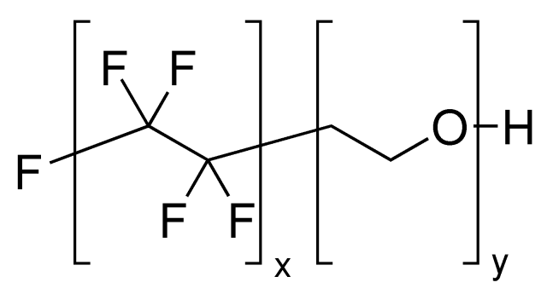
PFASs are all human-made:
1938
PFTE (teflon) is discovered
1951
DuPont begins using PFOA in teflon
production in West Virginia
1956
3M begins selling Scotchgard (PFOS)
1967
FDA approves Zonyl Food
packaging (PFOA)

Slide 8
Mid-Ohio River Valley
1970 – 1990’s: DuPont dumps ~7,000 tons of PFOA waste into the Dry Run Landfill on Tenant family farm; entire heard of 280 cattle dies
Over 70,000 residents exposed to PFOA laced water for decades
Tennant family sued Dupont 1999
NIEHS funds EJ study led by Ted Emmett (Penn.) and Decatur Community Association
-
2001: Rob Billot files class action lawsuit for 80,000 people
2005: DuPont settles class-action lawsuit $235 million and $16.5 settlement with the EPA, including funding C8 Study
Required to install water filtration system, but not eliminate chemicals
2012 C8 Science Panel released findings, links PFOA exposure to kidney cancer, testicular cancer, thyroid disease, high cholesterol, ulcerative colitis, pregnancy-induced hypertension
Notes:
Add transition

Slide 9

Social Discovery
Tennant Family Farm, Mid Ohio Valley. Source: New York Times
- Tennant family is the origins of the social discovery, very similar to so many contaminated communities
Notes:
1980 – 1990’s: DuPont dumps ~7,000 tons of PFOA waste into the Dry Run Landfill on the Tennant Family Farm.
1990 – 1999: Tennants notice environmental impacts on their farm (dying minnows, wildlife, etc.), then the cattle herd dies. No luck directly approaching DuPont or the WV DEP, so they eventually contact Bilott, a family friend.

Slide 10
Cottage Grove, MN
PFOA and PFOS
3M buried an estimated 45 tons of PFAS waste at local Woodbury landfill
Estimated 50,000 pounds of PFAS released into the Mississippi River each year
2002: MPCA* and Residents told 5/6 of their wells were contaminated with PFOA and PFOS
  Chemicals from local 3M plants
October 2004: Residents file a lawsuit against 3M, citing increased risk of cancer and asthma
  Seeking environmental cleanup, health monitoring, and monetary damages; suit dismissed

Slide 11
Hoosick Falls, NY
Up to 662ppt of PFOA in municipal drinking water (June 2015)
Up to 18,000ppt in groundwater near Saint Gobain plant (June 2015)
Contamination found by local resident that tested the municipal water himself after hearing about cases in the Mid-Ohio River Valley and Cottage Grove.
Nov 10, 2015: residents officially learn from local manufacturer Saint Gobain that their water has tested positive for PFOA
  Saint Gobain pledged to install water filtration system and provide bottled water to residents

Slide 12
Hoosick Falls, NY
PFOA
Community Action
Residents established Healthy Hoosick Water, a community activist group lead by a local doctor who claims to have personally witnessed the health consequences of the village’s contamination
Jan 27, 2016: Hoosick Falls listed as state superfund site by NY Department of Health
Feb 21, 2016: Class action lawsuit filed against Saint Gobain Performance Plastics and Honeywell International

Slide 13

Journalist Exposé
Written by Ohio-based newpaper reporter and radio news director, Callie Lyon
Follows the C8 issue from its first widespread attention in the 1980s to the announcement of the EPA phase-out and class action lawsuits against DuPont
By Callie Lyons
Published 2007

Slide 14
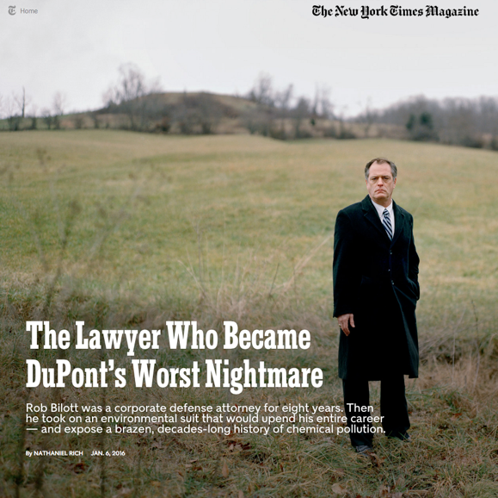
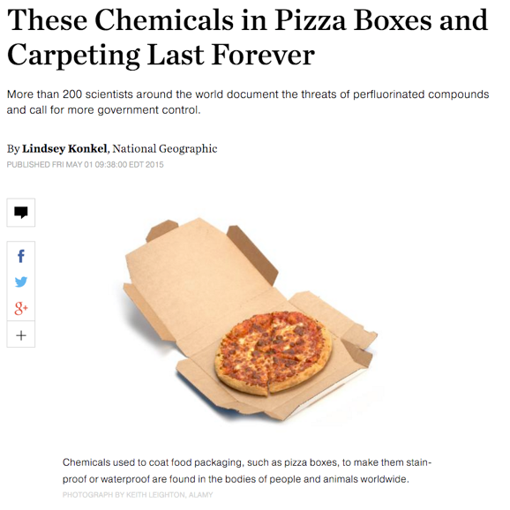


Media Attention
January 6, 2016
May 1, 2015

Slide 15
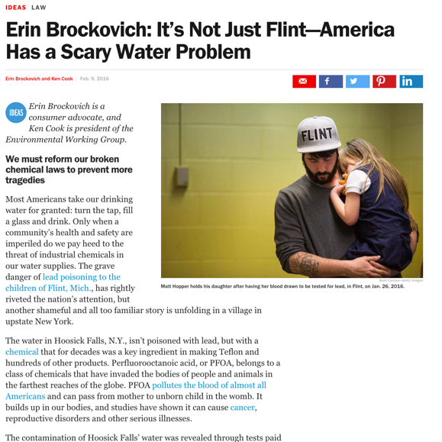
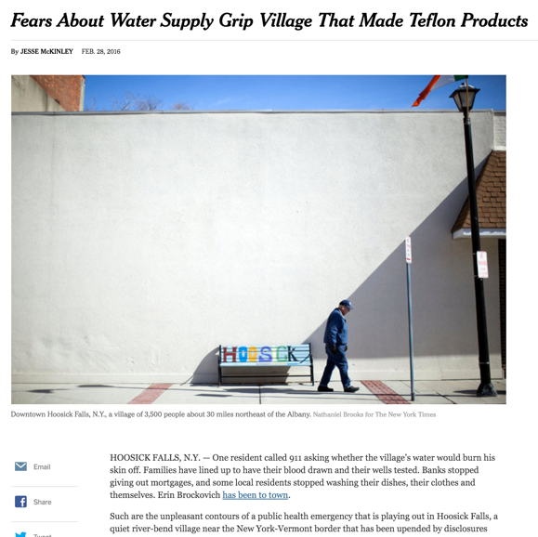

Media Attention
February 9, 2016
February 28, 2016

Slide 16

Community Organizing – Highlight on
Testing for Pease – Portsmouth NH
Leaders from left to right:
Alayna Davis
Michelle Dalton
Andrea Amico
With support from Portsmouth resident and Harvard SPH epidemiologist Courtney Carignan

Slide 17

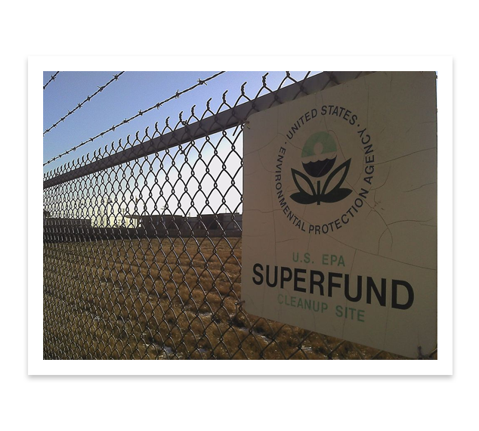
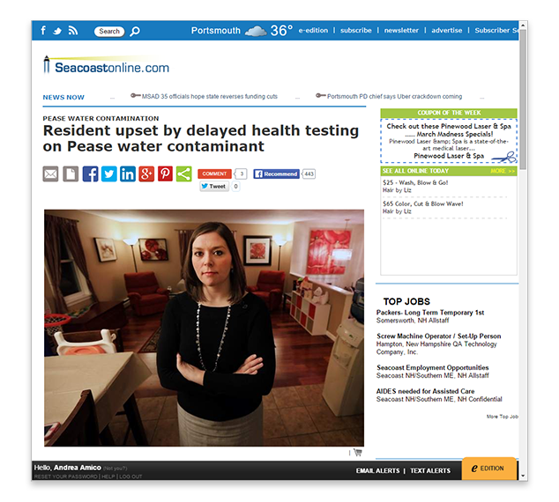
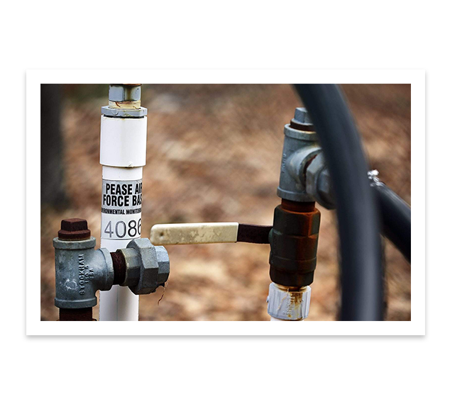
Pushed for blood testing by NH Health Dept.
Organized residents
Recruited health and public health professionals to design research and develop communications and education
Helped other communities learn how to deal with newly-discovered PFAS contamination
Presented at professional and activist conferences
Key planners for June 2017 conference

Slide 18
Pease vs NHANES

Slide 19
Scientific Discovery:
What Did Industry Know?
1981, 3M provided DuPont and the EPA the results of an internal laboratory study finding that pregnant rats exposed to PFOA experienced birth defects in pups
Documents later obtained in litigation indicate that DuPont began closely monitoring the health of female staff in the Teflon division of the Washington Works Plant due to 3M’s 1981 research.
1981 -female DuPont employee in the Teflon division, Sue Bailey, gave birth to a baby with severe birth defects. (2 out of 7 births)
A colleague put Sue Bailey in touch with another worker in the Teflon division whose baby born with eye deformities.
1981 - DuPont removed all female staff from the Teflon unit, notified employees to speak with medical staff prior to getting pregnant

Slide 20
What Did Industry Know?
1982 – DuPont shares new animal data with EPA but says nothing about birth defects
DuPont withheld the company’s concerns about exposure and risk from fenceline communities in the Mid-Ohio Valley near its Parkersburg, WV plant

Slide 21
Government Response

Slide 22
PFOA Stewardship Program
Initiated in 2006
EPA program established in cooperation with eight major manufacturers for two goals:
Commit to achieve a 95% reduction in both facility emissions to all media of PFOA, precursor chemicals, and related higher homologue chemicals by 2010
Commit to working towards the elimination of these chemicals from emissions and products by 2015

Slide 23
US EPA Provisional Health Advisory Levels
For SHORT TERM EXPOSURE
Levels set in 2009
400ppt
“reflect reasonable health-based hazard concentrations above which action should be taken to reduce exposure to unregulated contaminants”
-EPA Office of Water 2009
200 ppt
400ppt
200ppt
PFOA
PFOS
*
ppt = parts per trillion

Slide 24

EPA 2016 Advisory
Combined PFOA and PFOS = 70 ppt
Not regulatory
EPA Unregulated Contaminants Monitoring Rule (UCMR) is major source of data for large water systems – potential to contribute to extensive local prevention and remediation

Slide 25

State-Level Drinking Water Guidelines
PFOA alone has been detected in 94 public water systems in 27 states
Note: DuPont and 3M influence
Minnesota
300
ppt
20
Vermont
ppt
40
New Jersey
ppt
500
West Virginia
ppt
*
ppt = parts per trillion
New Jersey considering 14 ppt advisory

Slide 26
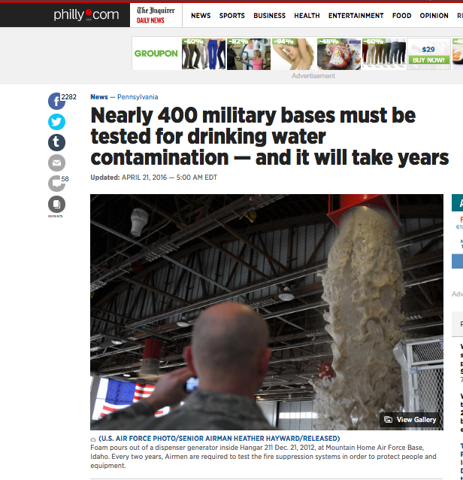

Slide 27
In light of “emerging contaminants” and just for comparison:
Social and scientific discovery around flame retardants

Slide 28
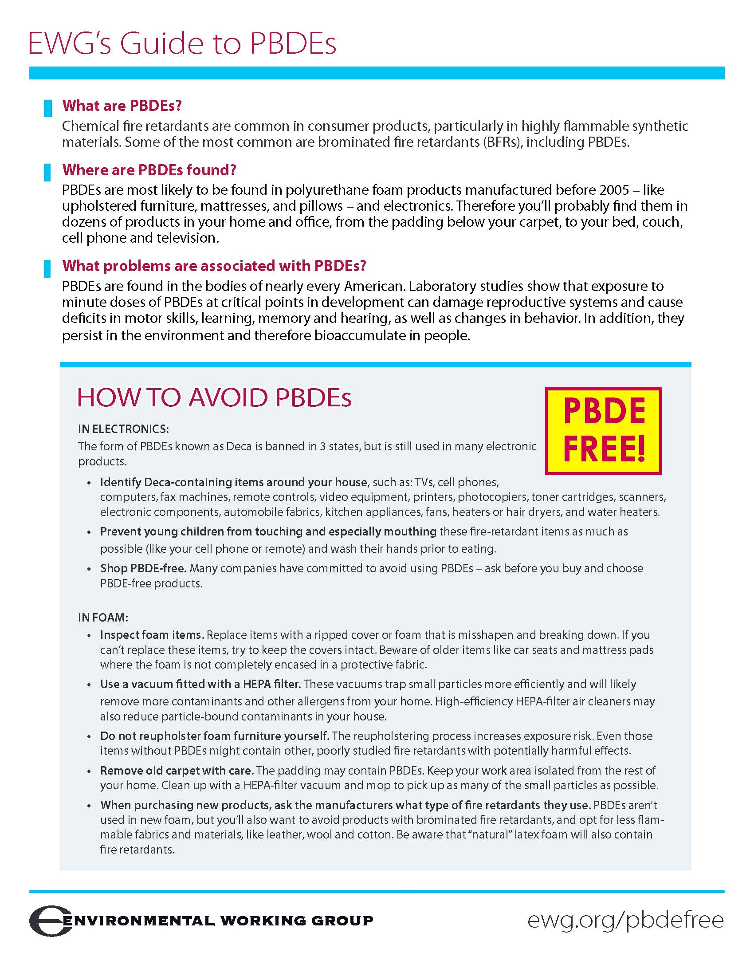
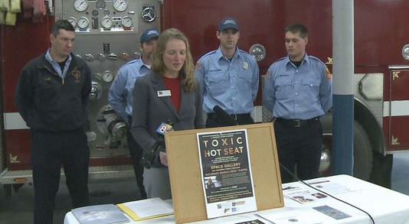
Multisectoral Alliances:
Flame Retardant Regulation
Academic and regulatory scientists
Scientist-advocates
Environmental and health social movement organizations
State and federal legislators and regulators
Federal funding institutions
Supply chain manufacturers
Firefighters and fire safety experts
Healthy hospitals and health care advocates
Journalists
Cordner and Brown – 2013 Environmental Sociology article “A Multisector Alliance Approach to Environmental Social Movements

Slide 29
Multisectoral Alliance Potential: PFAS
Academic and regulatory scientists
Scientist-advocates
Active military and veterans
Environmental and health social movement organizations
Water utilities
State and federal legislators and regulators
Federal funding institutions
Supply chain manufacturers
Lawyers
Journalists

Slide 30
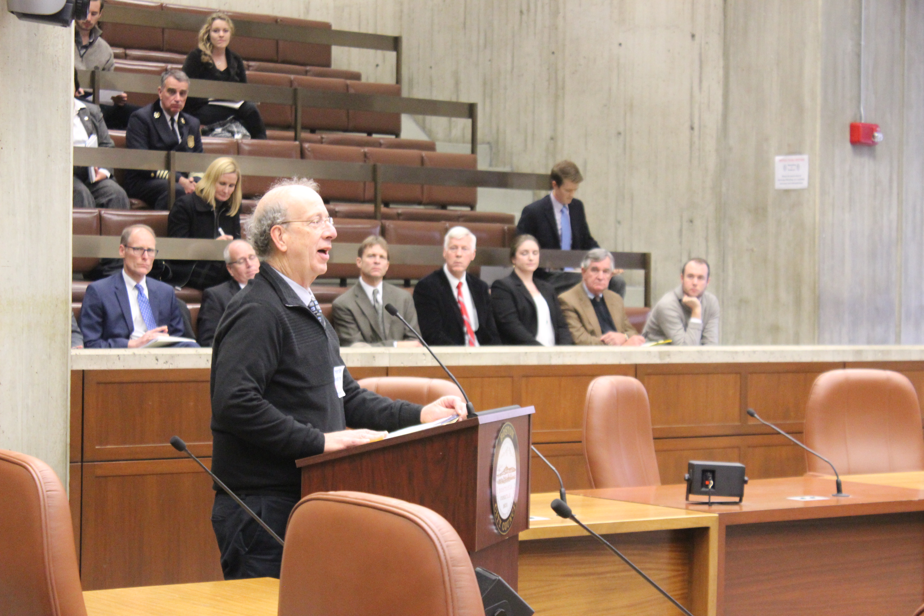
Our engagement – Flame Retardants
Sign San Antonio Statement published in December 2010 issue of Environmental Health Perspectives –signed by over 200 scientists from 30 countries
Present at Green Science Policy Institute conference
Work with national coalition to seek chemical reform
Work with Boston area group working to reduce FR use in hospitals, universities, and other locations
Meet with Massachusetts fire safety officials to prompt them to follow California reform - success
Testify at Boston City Council on
regulatory reform - success

Slide 31
Our engagement – PFAS
Sign Madrid Statement published May 2015 issue of Environmental Health Perspectives - Signed by over 230 scientists from 40 countries
Interview with Politico criticizing NYDOH report that minimizes risks and makes errors on health effects; respond critically to NYDOH requests for our comments on their report
Write letter to NHDHHS to request they share data with Portsmouth residents
Press ATSDR to collaborate on research
Provide technical and social support to Portsmouth residents’ group Testing for Pease
Construct national database of contamination sites and share with communities, scientists, government, lawyers, environmental groups
Present panel with affected residents and scientists at Toxics Action Center conference March 2016
Meet with TAC afterward to plan further involvement
Coordinate with TAC on research visits to Bennington VT and Westfield MA
Organize national conference for June 2017

Slide 32
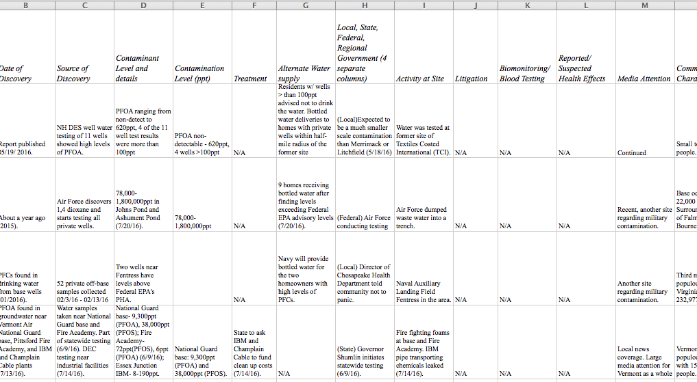

Contamination Site Database
New Collaboration: Environmental Working Group is putting our database into a searchable map to be launched a week or two before our June conference

Slide 33
FDA de-lists three types of food packaging containing PFAS Dec. 29, 2015
But these uses are already discontinued
Regulation after-the-fact
Whack-a-mole
Market engagement: sometimes easier and/or faster to get results from corporate cooperation than government regulation
Organizing potential: unique - done by petition from NRDC, with additional co-signing organizations: Breast Cancer Fund, Center for Environmental Health, Center for Food Safety, Center for Science in the Public Interest, Children’s Environmental Health Network, Clean Water Action, Environmental Working Group, and Improving Kids’ Environment.

Slide 34
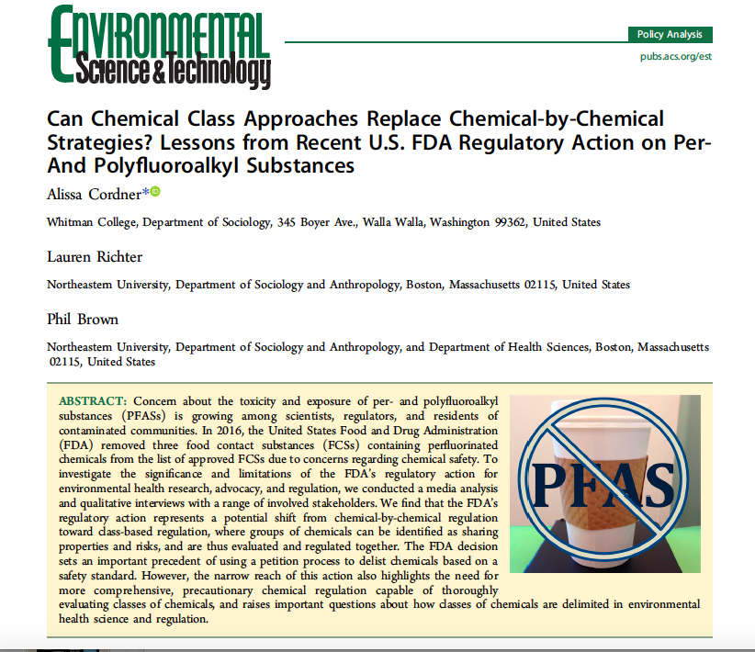

Slide 35
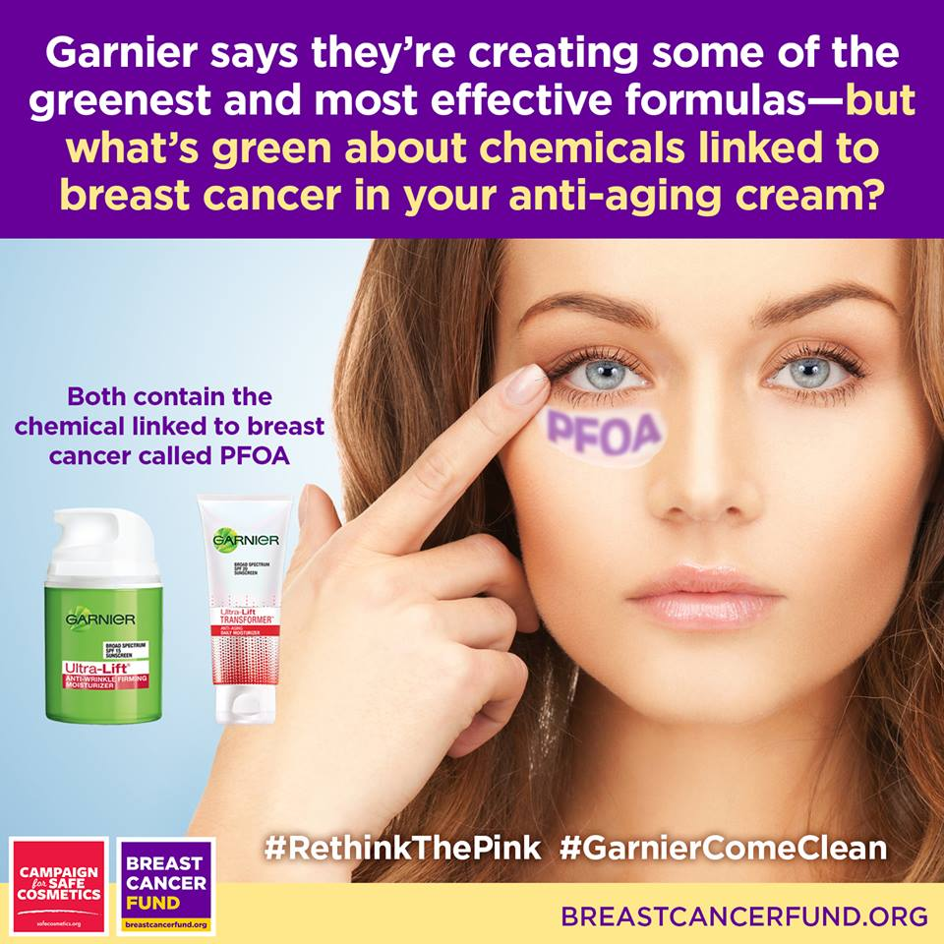
Notes:
Start with the fact that most Americans assume that ingredients in consumer products are safe. Then flip to this slide…one would never think that a potentially toxic chemical would be hiding in your anti-aging cream.

Slide 36
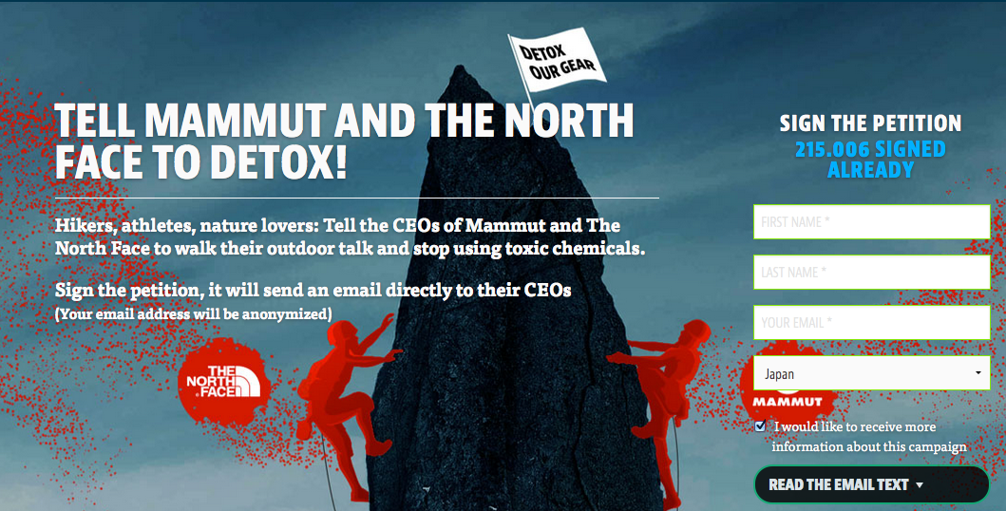
Notes:
Greenpeace also has an ongoing campaign targeting outdoor brands

Slide 37

Voluntary commitment to eliminate PFAS
Notes:
Coop Denmark as the main example

Slide 38
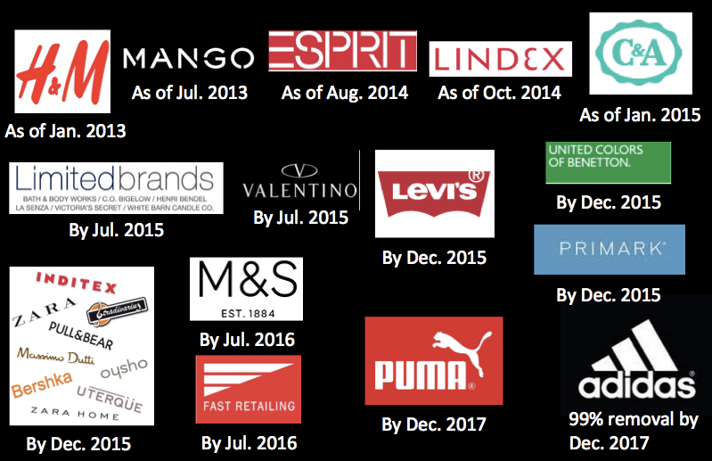
All products from these apparel brands will be free of long-chain fluorinated chemicals after those dates.

Slide 39
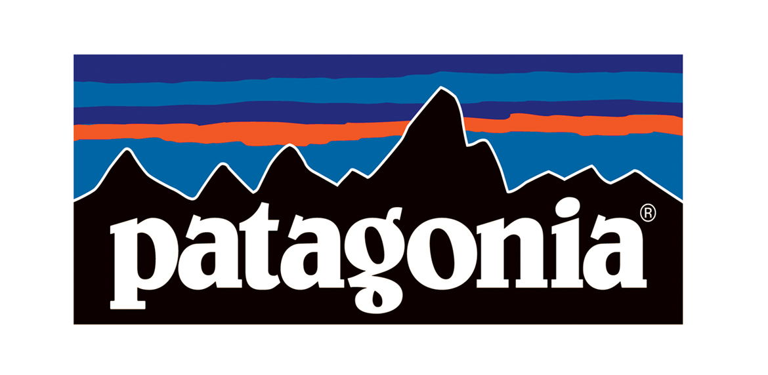

Corporate Investment in Alternative Technologies
Notes:
Patagonia’s investment in BST

Slide 40
Potential for consumer action
Success already in limiting PFASs in products, similar to flame retardant consumer activism
We know that ultimately we can’t “shop our way to safety” (Andrew Szasz) but we can “organize our way to safety”

Slide 41
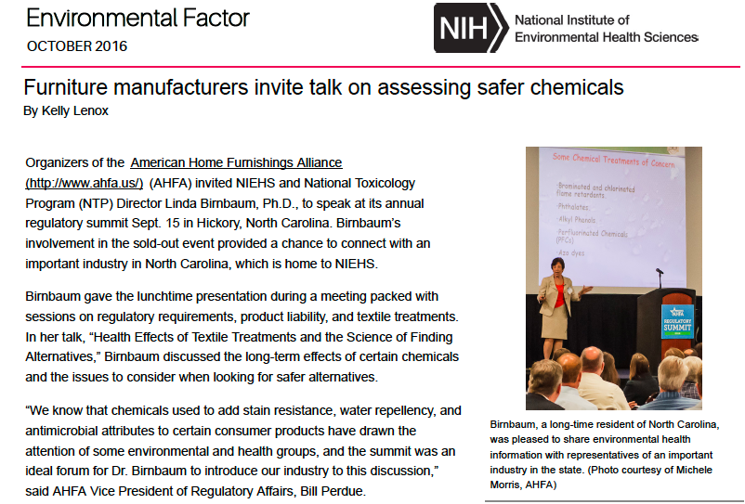
Dr. Birnbaum Plays a Role

Slide 42

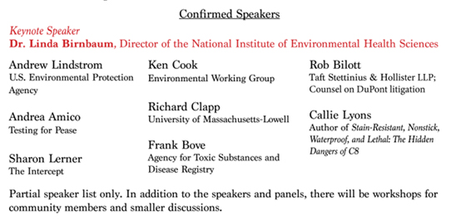
Northeastern sponsors Highly Fluorinated Compounds-Social and Scientific Discovery Conference
June 14-15, 2017
Full Agenda:
https://www.northeastern.edu/environmentalhealth/highly-fluorinated-compounds-social-and-scientific-discovery/

Slide 43
Day 1
8-8:15 Breakfast and registration
8:15-9:00 Welcome and Introduction to the Conference (as breakfast continues)
Phil Brown (Northeastern University)
Laurel Schaider (Silent Spring Institute)
Sylvia Broude (Toxics Action Center)
9:00-9:45 Keynote Address
Linda Birnbaum (Director, National Institute of Environmental Health Sciences)
Introduction by Michelle Dalton (Testing for Pease)
9:45-10:30 Social and scientific discovery - The legal angle
Rob Bilott (Taft Law; counsel on DuPont litigation)
10:30-10:45 Break
10:45-11:25 Social and scientific discovery – The national organization level
Ken Cook (Environmental Working Group)
11:25-12:45 State of the science on PFASs
– Chaired by Courtney Carignan (Harvard T.H. Chan School of Public Health)
Philippe Grandjean (Harvard T.H. Chan School of Public Health)
Alan Ducatman (West Virginia University)
Richard Clapp (University of Massachusetts-Lowell)
12:45-1:45 Lunch - this will include a separate room for community groups to discuss strategic planning
1:45-3:15 Community organizing (Military and airport sites)
– Chaired by Sylvia Broude (Toxics Action Center)
Andrea Amico (Testing for Pease – Portsmouth, NH)
Arnie Lariche and Cindi Ashbeck (Michigan Contaminated Water Group Affecting Veterans/Civilians Worldwide)
Hope Grosse and Joanne Stanton (Warminster, PA)
3:15-3:30 Break
3:30-5:00 Source identification and drinking water treatment
– Chaired by Laurel Schaider (Silent Spring Institute)
Elsie Sunderland (Harvard John A. Paulson School of Engineering and Applied Science)
Andrew Lindstrom (U.S. Environmental Protection Agency)
Brandon Kernen (New Hampshire Department of Environmental Services)
Mark Ells (Town of Barnstable, MA)
5:00-6:00 Social and scientific discovery: Building a broad coalition around chemical classes
– Chaired by Alayna Davis (Testing for Pease)
Alissa Cordner (Whitman College)
Lauren Richter (Northeastern University)
Tony Fletcher (London School of Hygiene and Tropical Medicine)
6:00-8:00 Informal networking dinner – options will be available at your own cost

Slide 44
Day 2
8:00-8:45 Breakfast
8:45-10:15 Scientists working with communities
– Chaired by Dick Clapp (University of Massachusetts-Lowell)
Edward Emmett (University of Pennsylvania)
Courtney Carignan (Harvard T.H. Chan School of Public Health)
Laurel Schaider (Silent Spring Institute)
Frank Bove (Agency for Toxic Substances and Disease Registry)
10:15-10:30 Break
10:30-12:00 Role of local, state, and federal agencies
– Chaired by Alissa Cordner (Whitman College)
Alyssa Schuren (formerly Vermont Department of Environmental Conservation)
Fardin Oliaei (DST Health Solutions; formerly Minnesota Pollution Control Agency)
Christina Bush (Michigan Department of Health and Human Services)
Sue Manente (Michigan Department of Health and Human Services)
12:00-1:00 Lunch
1:00-2:30 Community organizing (Industrial sites)
– Chaired by Shaina Kasper (Toxics Action Center)
Joe Kiger (Keep Your Promises DuPont – Parkersburg, WV)
Michelle O’Leary and Michelle Baker (Hoosick Falls, NH)
Tracy Carluccio (Delaware Riverkeeper)
Greg Madden (North Bennington Neighbors – North Bennington, VT)
Carol DiPirro (Citizens for Clean Water in Merrimack – Merrimack, NH)
2:30-3:30 Local and investigative media coverage
– Chaired by Sunshine Menezes (Metcalf Institute for Marine and Environmental Reporting)
Sharon Lerner (The Intercept)
Callie Lyons (author of Stain-Resistant, Nonstick, Waterproof, and Lethal: The Hidden Dangers of C8)
Mariah Blake (author of forthcoming Welcome to Parkersburg)
Emily Corwin (New Hampshire Public Radio
3:30-3:45 Break

Slide 45
Day 2 (continued)
3:45-5:00 Small Group Workshops
1) Is a Health Study Right for My Community?
Dick Clapp (University of Massachusetts-Lowell)
Greg Howard
Courtney Carignan (Harvard T.H. Chan School of Public Health)
2) Legal Considerations for Impacted Communities
Ken Rumelt (Vermont Law School Environmental and Natural Resources Law Clinic) Kevin Hannon (class action lawyer on PFAS in Merrimack NH)
3) How to Build Positive Relationships with Legislators
Rep. Mindi Messmer (New Hampshire State Representative District 24)
Senator Brian Campio (Vermont General Assembly – Bennington County)
Bill Couzens (Less Cancer)
Alyssa Schuren (formerly Vermont Department of Environmental Conservation)
4) Beyond Water: Retailer and Manufacturer Action on PFASs in Consumer Products
Laurel Schaider (Silent Spring Institute)
5) Effective Strategies for Engaging with Media
Kyle Bagenstose and Jenny Wagner (Bucks County Courier Times)
6) How Health Professionals Can Help Affected Communities
Alan Ducatman (West Virginia University)
Lili Wierbonics (Pediatric Associates – Portsmouth, NH)
5:00-5:30 Closing comments and future directions
Alissa Cordner (Whitman College)
Andrea Amico (Testing for Pease)
Shaina Kasper (Toxics Action Center)

Slide 46
Publications and works in progress
Alissa Cordner, Lauren Richter, Phil Brown. 2016. “Can Chemical-class Approaches Replace Chemical-by-Chemical Strategies? Lessons from Recent FDA Regulatory Action on Perfluorinated Compounds.” Environmental Science & Technology 50(23): 12584-12591.
Matthew Judge, Phil Brown, Julia Brody, Ruthann Rudel, and Serena Ryan, “The Exposure Experience: Participant Responses to a Biomonitoring Study of Perfluorooctanoic Acid (PFOA).” Journal of Health and Social Behavior. 2016 57: 333-350
In progress
The Sticky Science of Non-Stick Chemicals: Forty Years of Research and (In)Action on Fluorinated Compounds
Risky Business? Manufacturer, Retailer, and Consumer Campaigns to Reduce Emerging Chemical Exposure
From Community to Courtroom: Litigation and Environmental Justice in the Case of PFAS Contamination
PFASs Past and Present: PFASs as Re-Emerging Contaminants
Strategic Science Production
PFAS Research and Potential Funding Effects

Slide 47

Visit our website: PFASPROJECT.COM
Includes Contamination Site Tracker

Slide 48
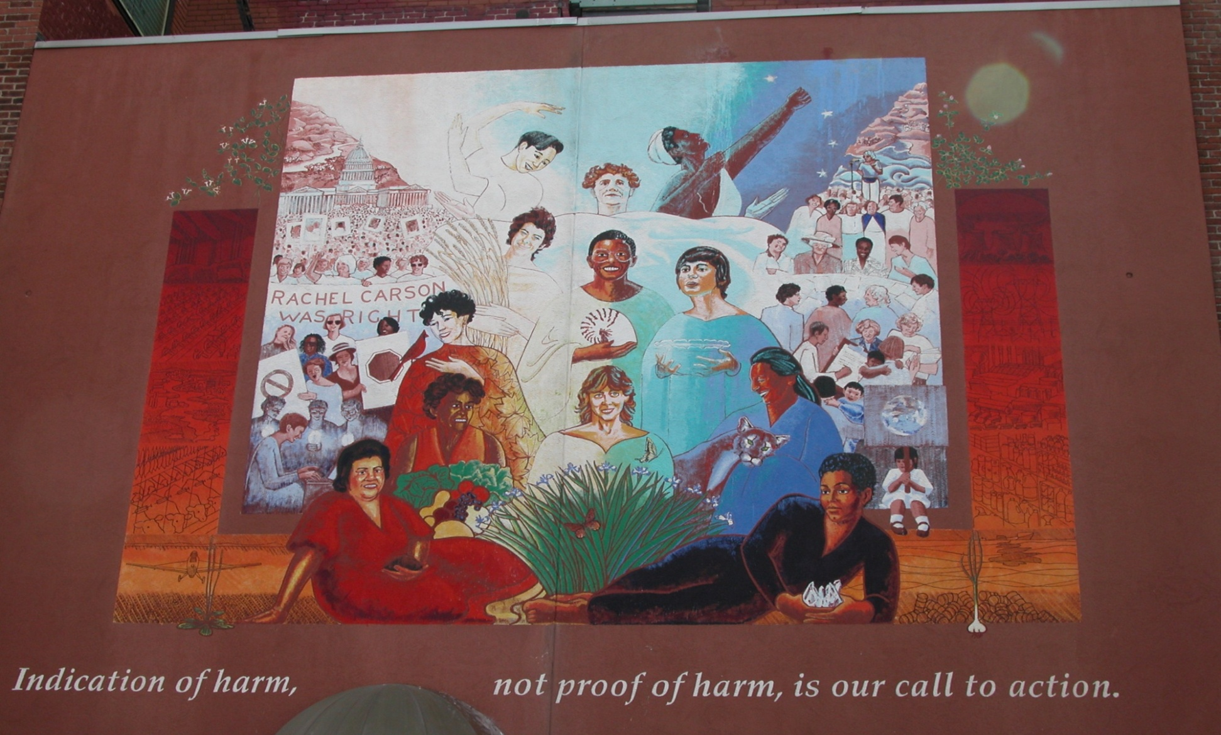
http://www.northeastern.edu/environmentalhealth/

